Slide 1
UNIT-VI

Slide 2
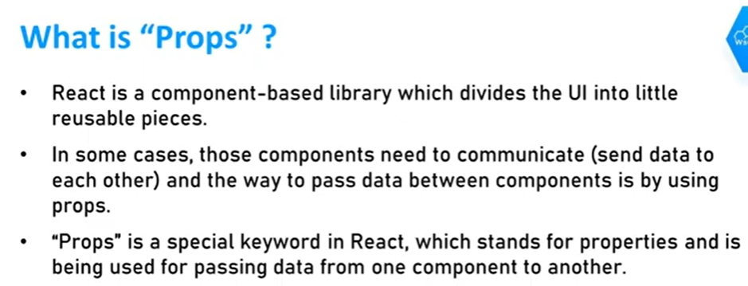

Slide 3
Important part here is that data with props are being pass in a uni-directional flow.(one way from parent to child)

Slide 4
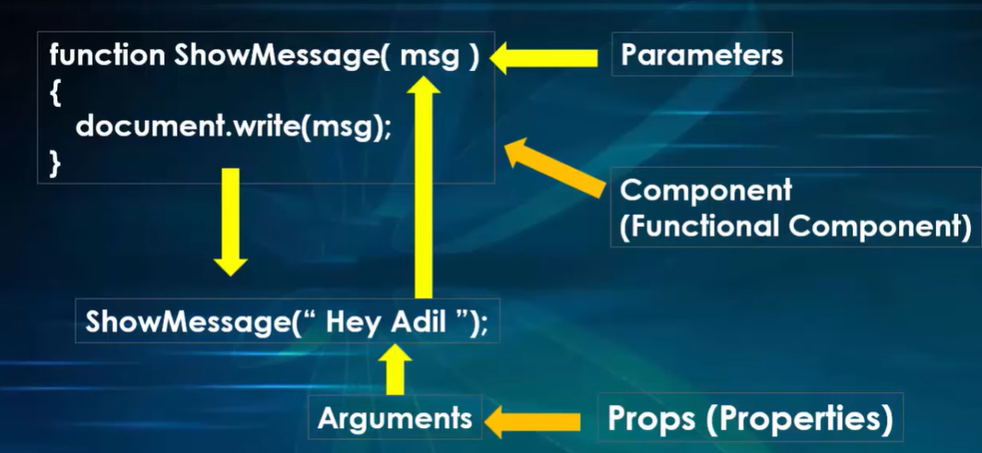
PROPS

Slide 5
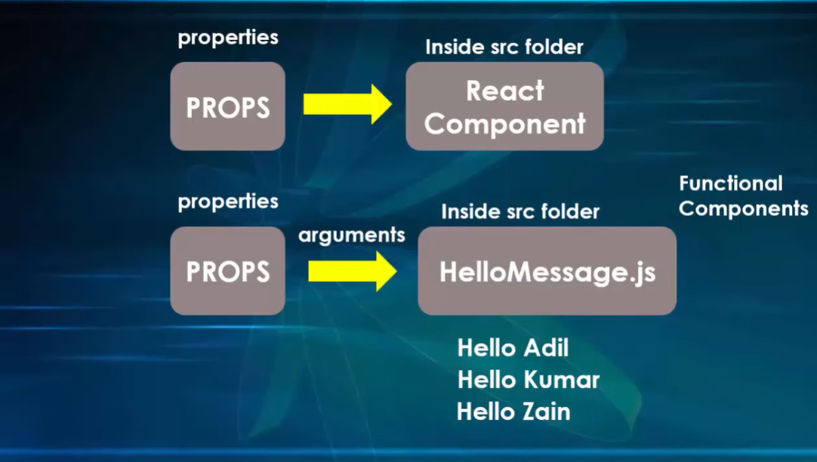

Slide 6
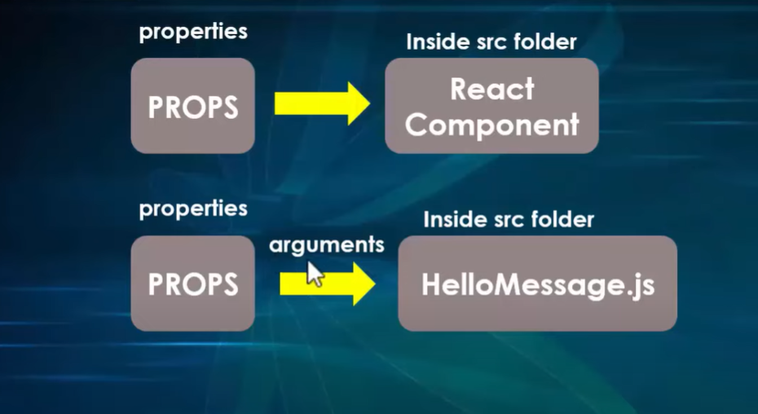

Slide 7
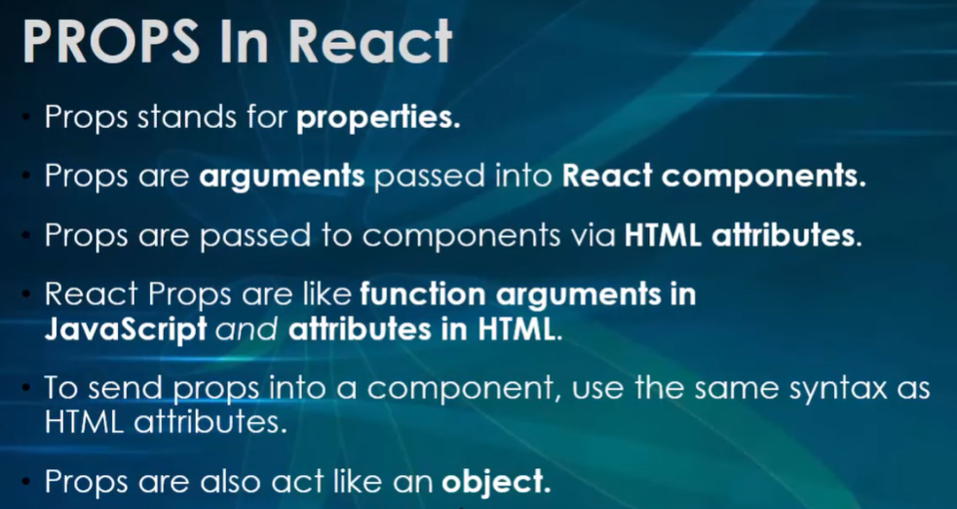

Slide 8
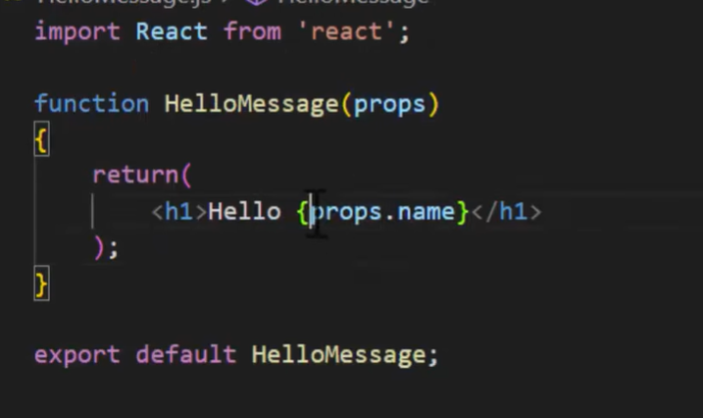
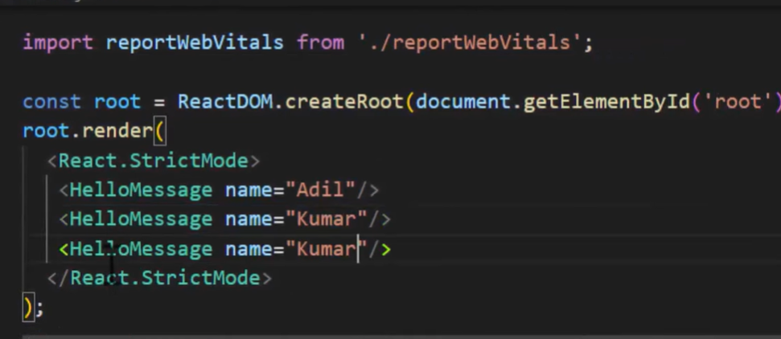

Slide 9
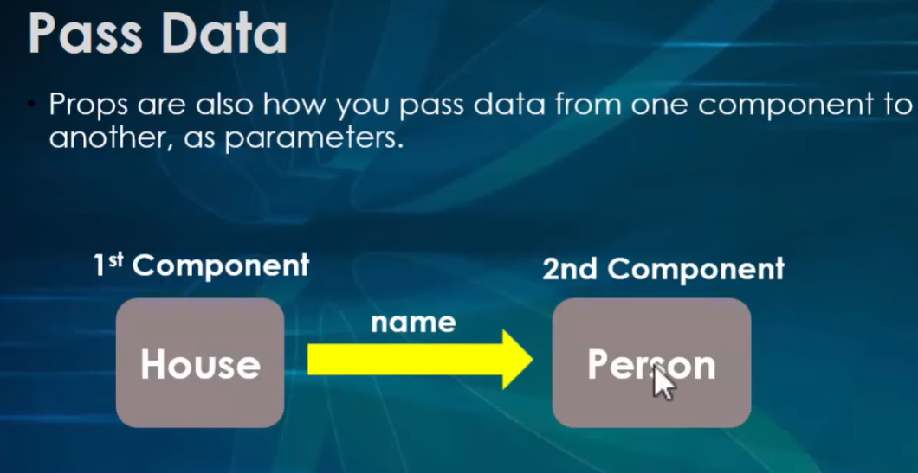

Slide 10
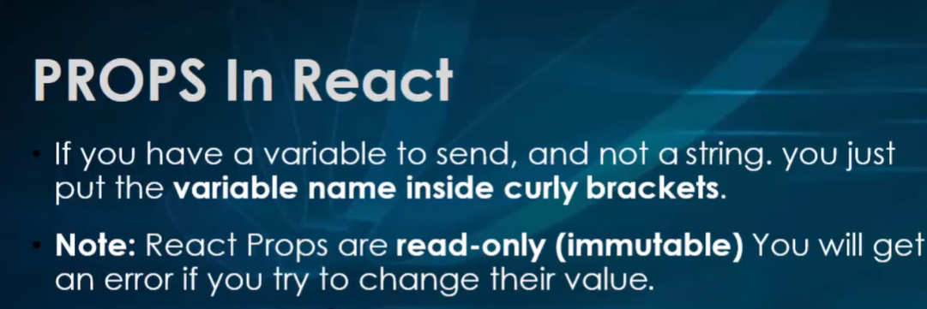

Slide 11
Props Validation
Props as Mandatory-
If you want to require anyone who uses your component to always pass a certain prop, you can always pass it as mandatory.
Specifying the valid range of props-
From time to time you might want to prop value passed, That is exactly same as a set of values passed.
Specifying a set of types of prop-
You can specify a set of types for a prop.

Slide 12
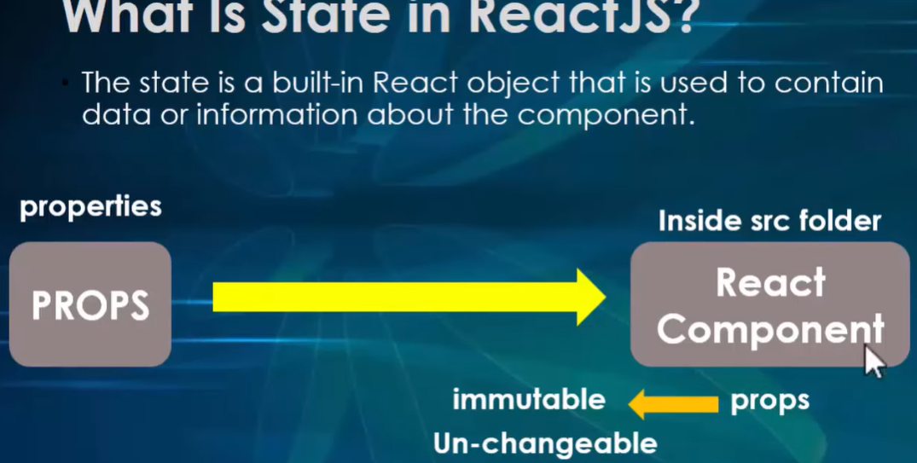
State in ReactJS

Slide 13
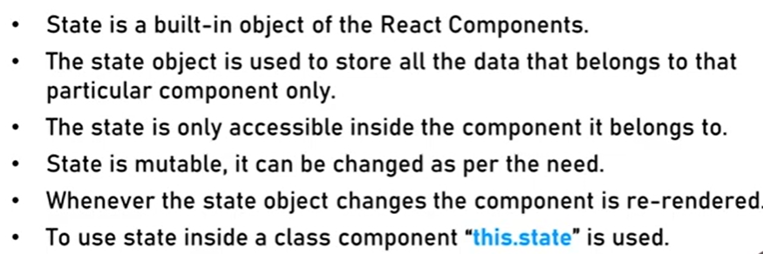
State in ReactJS

Slide 14
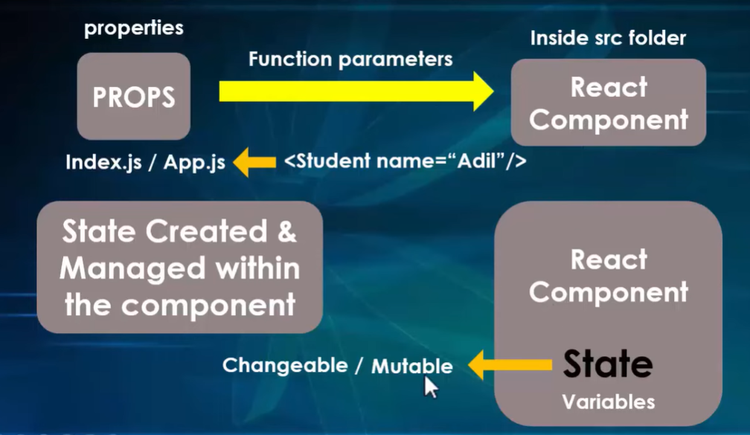
State in ReactJS

Slide 15
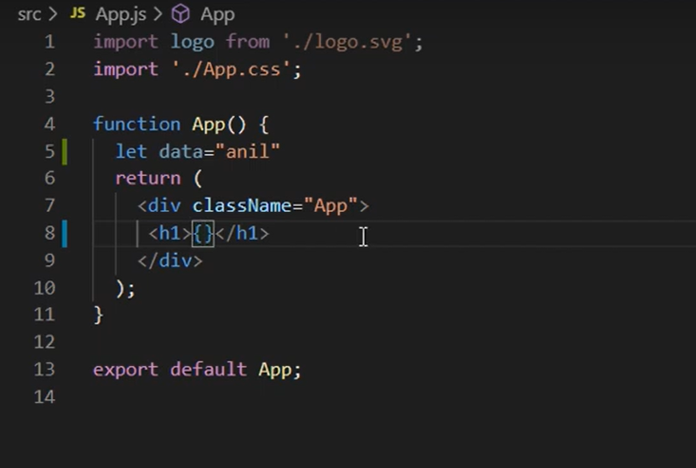
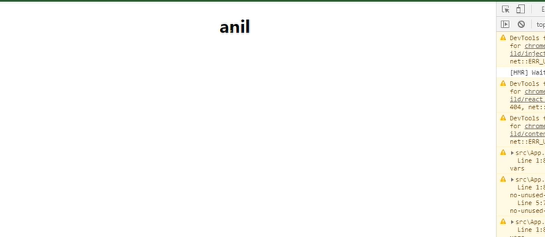
Example-
OUTPUT

Slide 16


OUTPUT-
ONCLICK

Slide 17


Slide 18
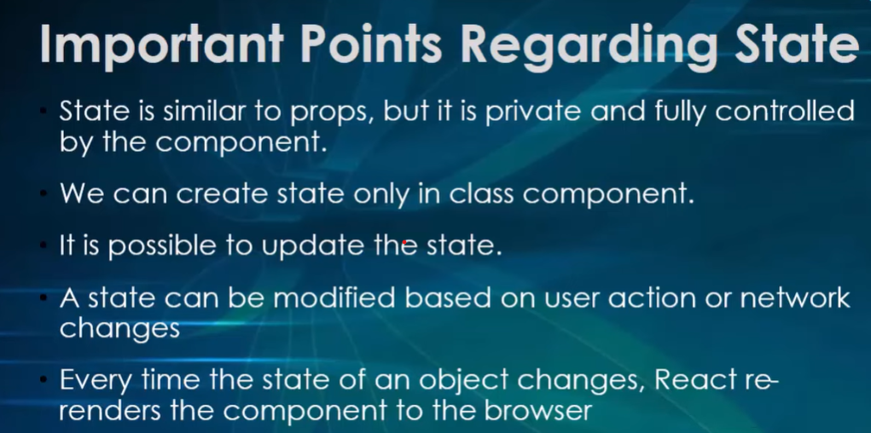

Slide 21
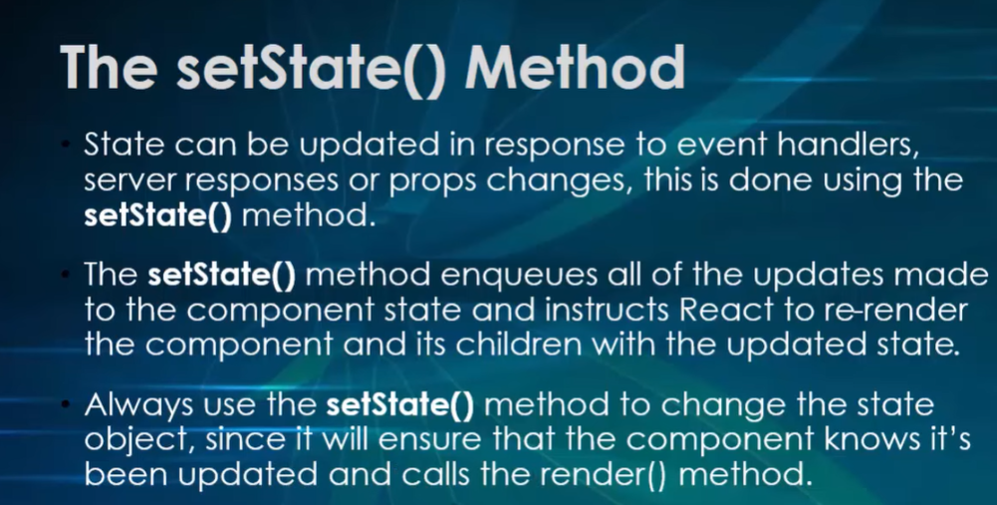

Slide 22
Difference Between Props and State
Props get passed to the component.
Function parameters.
Props are immutable/unchangeable.
State is created and managed within the component.
Variables.
State is mutable/Changeable.

Slide 23
State with in the component Tree
In many React applications, it is possible to group all state data in the root component.
State data can be passed down the component tree via properties, and data can be passed back up the tree to the root via two-way function binding.
The result is that all of the state for your entire application exists in one place.

Slide 24
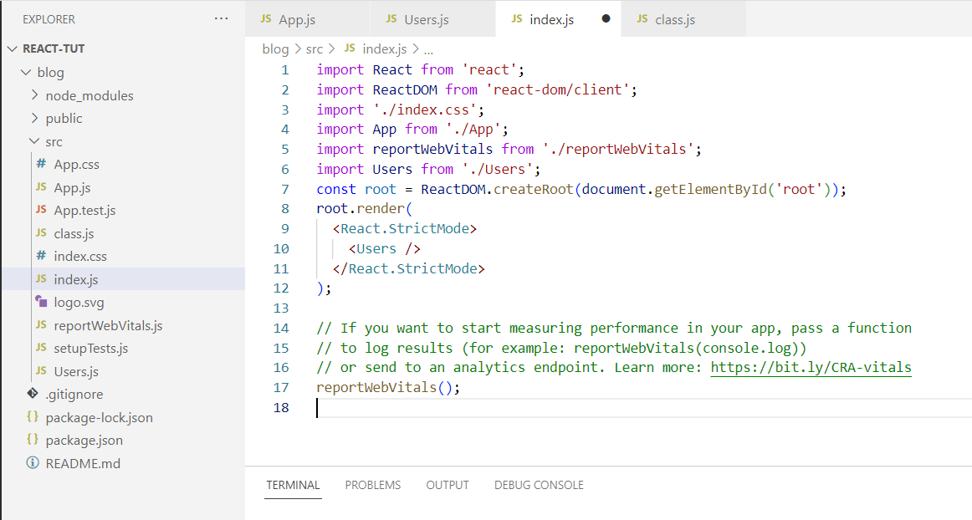
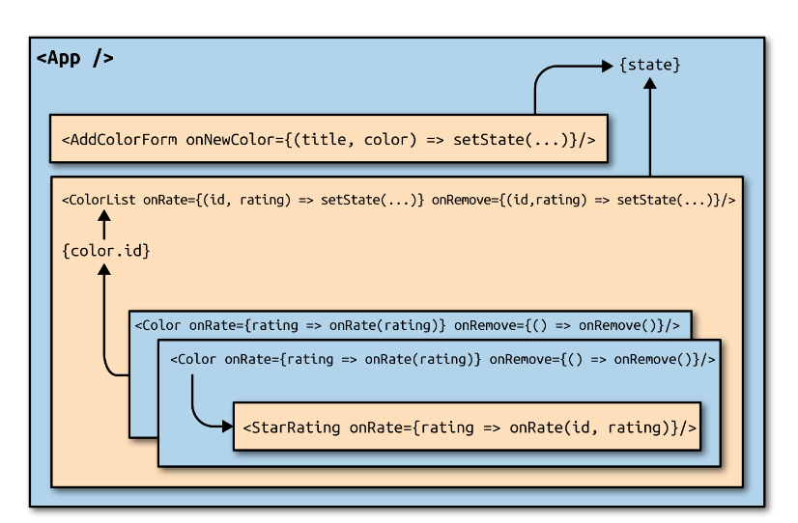
State with in the component Tree

Slide 25
React Router
React Router is a JavaScript framework that lets us handle client and server-side routing in React applications.
It enables the creation of single-page web or mobile apps that allow navigating without refreshing the page.
It also allows us to use browser history features while preserving the right application view.
There is no refreshing or reloading of the Web page.

Slide 26
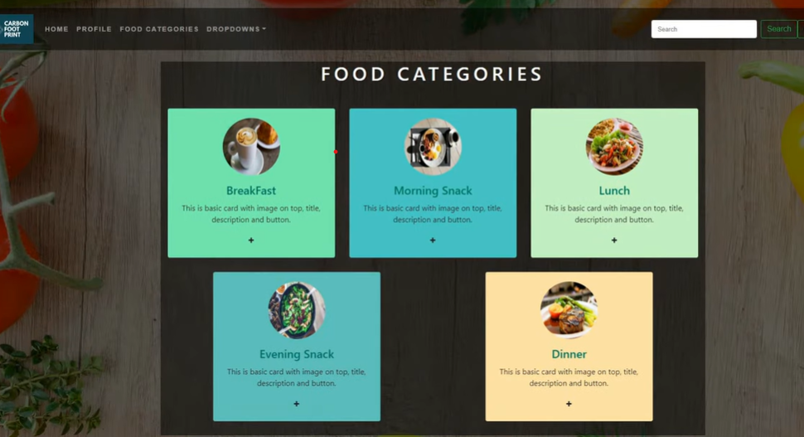
Router in React

Slide 27
React Router
Create React App doesn’t include page routing.
React Router is the most popular solution.
To add React router run this command is-
npm install react-router-dom
It’s a fully-featured client and server-side routing library for react.
Helps and navigate between different URL’s and make up your web application.
Provides unique URL for different component in the app and makes the UI easily sharable with others users.

Slide 28
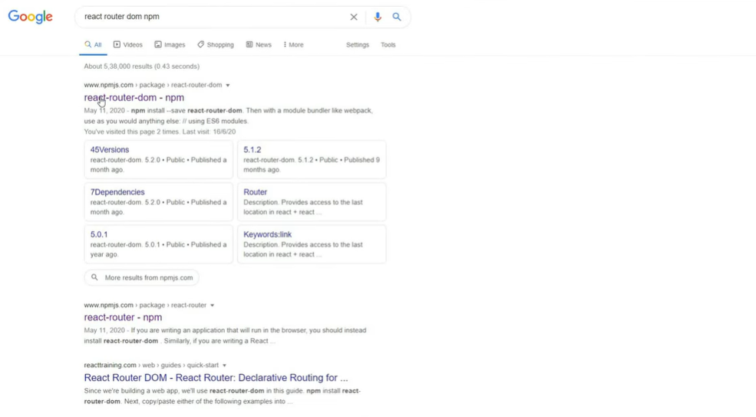

Slide 29
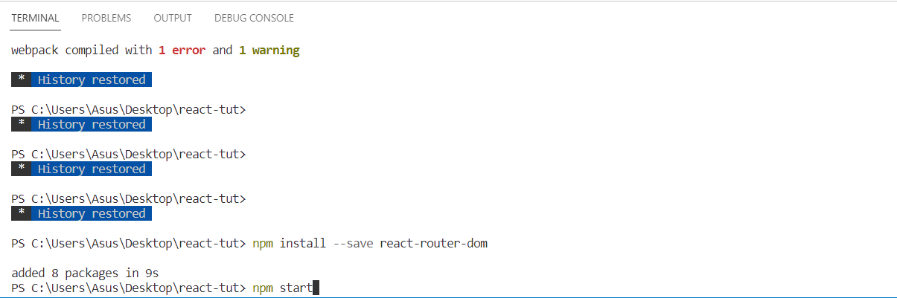

Slide 30
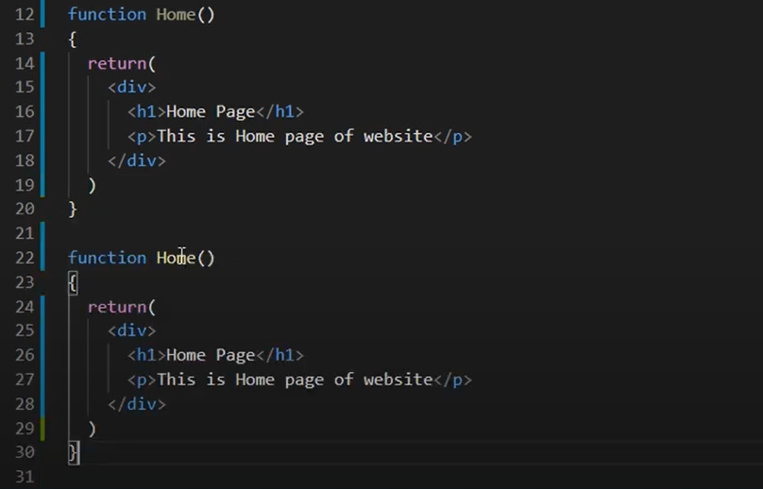
Example-
Create two function component in App.jsx. Home and About.

Slide 31
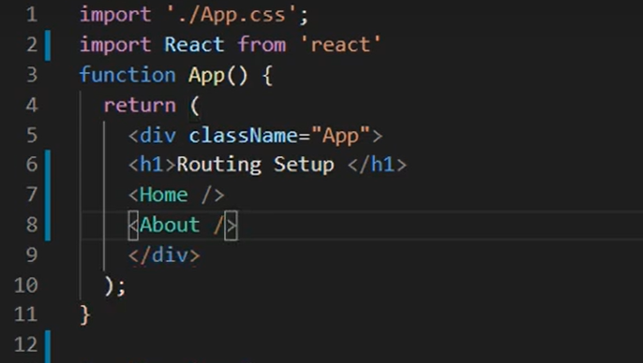
In App.jsx function is created that is App function within it import the function which were created i.e., Home and About.

Slide 32
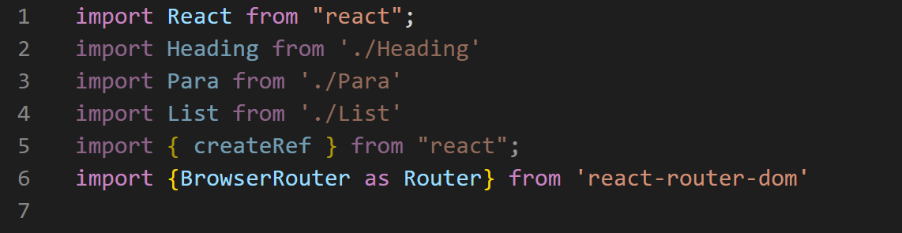
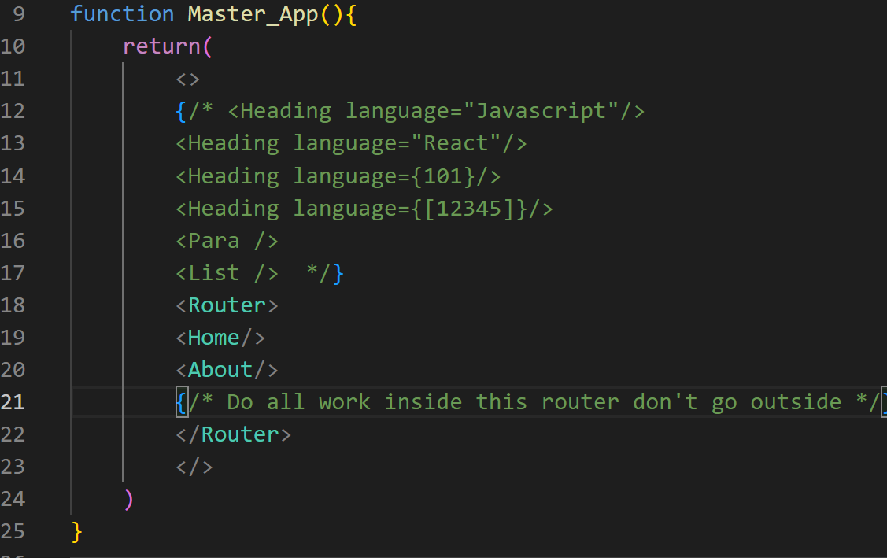
Add the header file in it of router as shown below. And all the multiple tags will be writer under Router

Slide 33

Output-

Slide 34
Types of Routing
Static Routing (As shown in previous example)- You need to define all the routes in a centralised location in your application. Then these routes will be imported at the top level of the application before it start rendering.
Dynamic Routing- The main difference between static and dynamic routing is the time at which the routing takes place. In dynamic routing, routes are initialized dynamically when the page is rendered.

Slide 35
Parameters in React Router
In react app sometimes we want to access the parameters of the current route in this case useParams hooks come into action.
Example- Parameter passed is id we want to access that parameter in our page for that we use useParams hook.
The react-router-dom package has useParams hook that let you know access the parameter of current hook. [It will get the current route parameter.

Slide 36
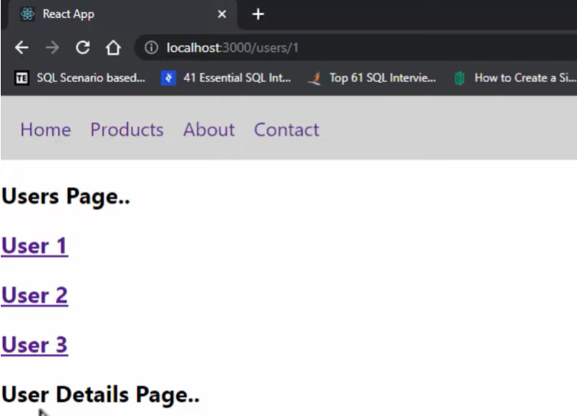
Parameters in React Router

Slide 37
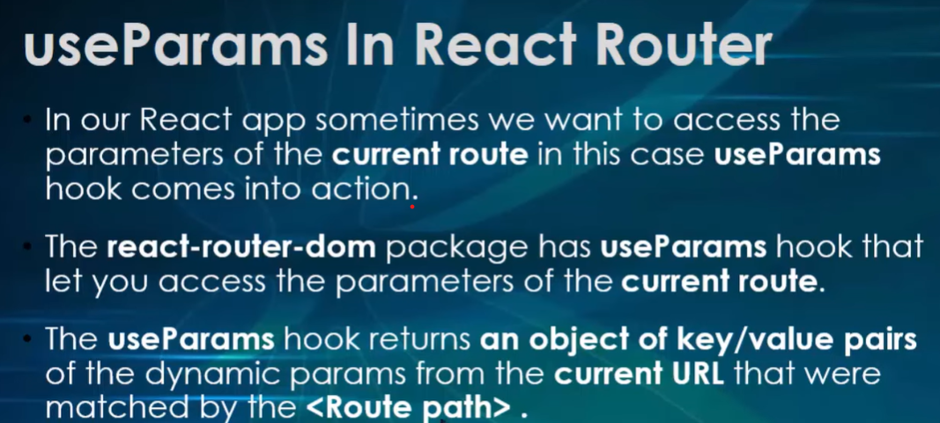

Slide 38
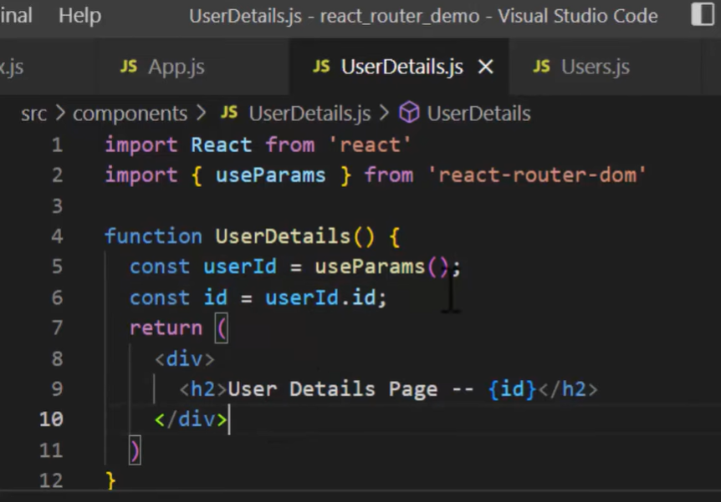
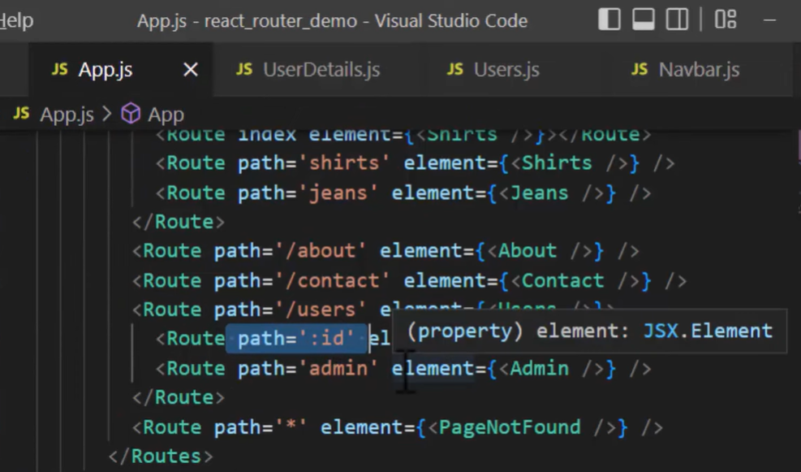
Parameters in React Router

Slide 39
Ref in React
Use ref in project as less as possible.
Avoid the manipulation of the DOM directly, instead use state and props.
They are used -
for references in react, to store a reference to particular DOM node.
To interact with React DOM node or react element.
To change the value of a child without using props.
In form we can use, if to get the value from the form, validation also to applied, and colour in form is to apply then you can use the concept of ref.

